Slide 1
Plant classification
Year 7 Science

Slide 2
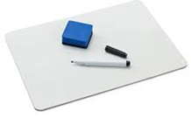
Review
What do plants and fungi have in common?
What do animals and fungi have in common?
What does photosynthesis mean?
Which type of plants do not have roots or stems?
Which type of plants have roots but no stems?
Which type of plants have seeds in cones?

Slide 3
Learning Intentions
Grouping a variety of organisms on the basis of similarities and differences in particular features

Slide 4
Success criteria
Observe features that are used to classify plants.
Use a key to classify plant species.

Slide 5
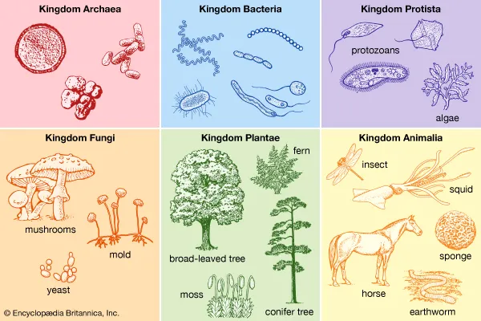

Slide 6
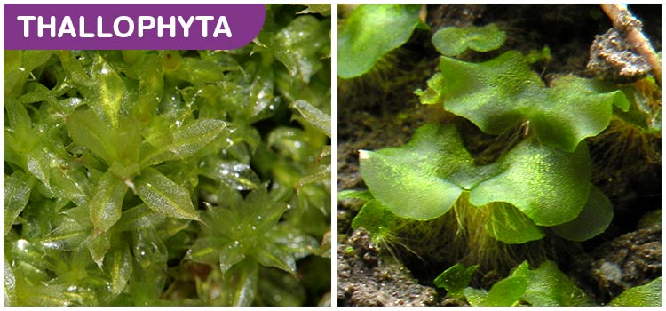
Algae

Slide 7
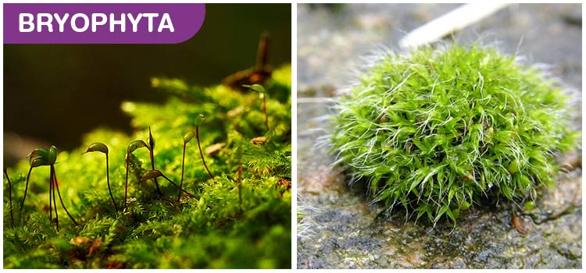
Moss

Slide 8
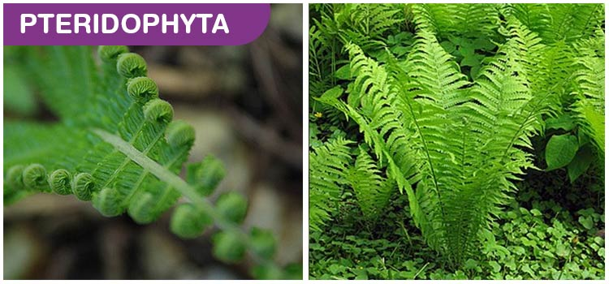
Fern

Slide 9
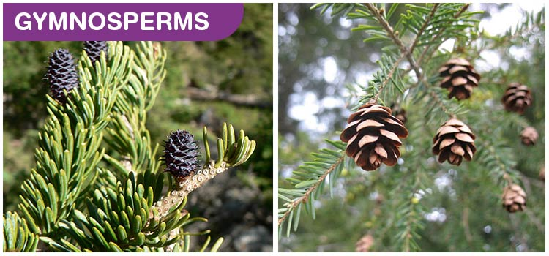
Conifers

Slide 10
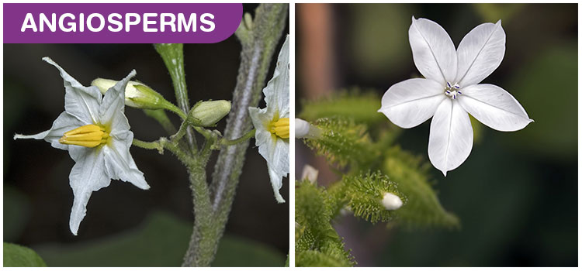
Flowering plants

Slide 11
Activity: Dryandra Woodland Species
Rules:
Time limit
Boundaries
Watch for spiky and poisonous plants
Every group member must complete their own booklet
Respect nature, equipment, other classes and each other

Slide 12
Success criteria
Observe features that are used to classify plants.
Use a key to classify plant species.

